Slide 1

Car Insurance Analysis &Dashboard
For this assignment, I first generated a synthetic dataset using Python based on the given business assumptions. The dataset was then imported into MySQL, where I performed data analysis and wrote SQL queries to extract key insights related to premiums, claims, and profitability. Finally, I connected the processed data to Power BI to build interactive dashboards and visualizations that highlight claim trends, loss ratios, and overall portfolio performance.
Presented By: Muskan Singh

Slide 2
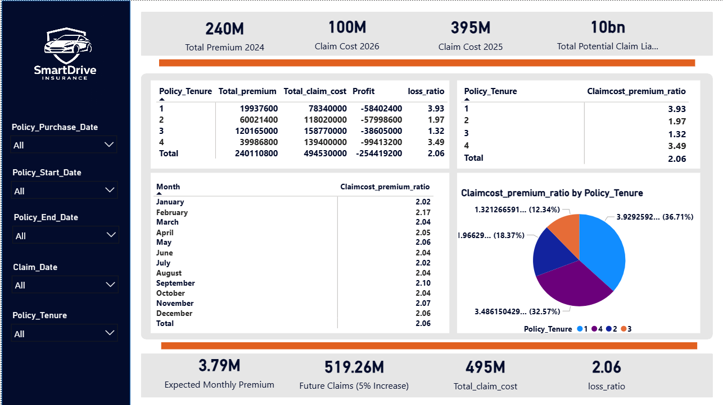

Slide 3
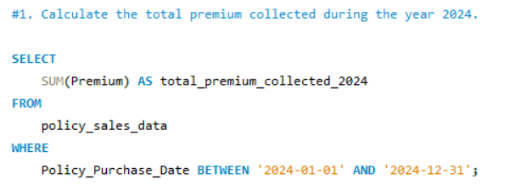

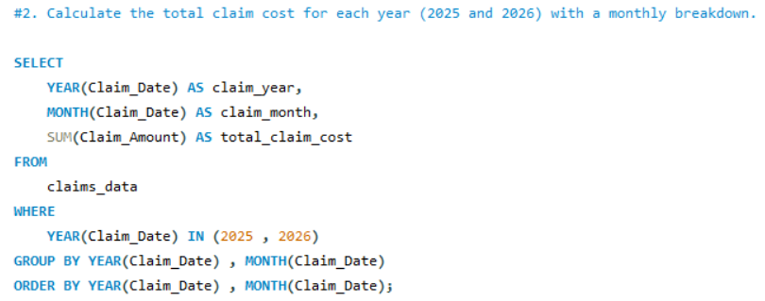
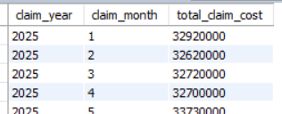
SQL Queries Analysis
I used the SUM aggregation function to calculate the total premium and filtered the records using the YEAR() function to include only policies sold in 2024.
I extracted the year and month from the
claim date and grouped the data by these fields to
calculate the total claim cost for each
month in 2025 and 2026.

Slide 4
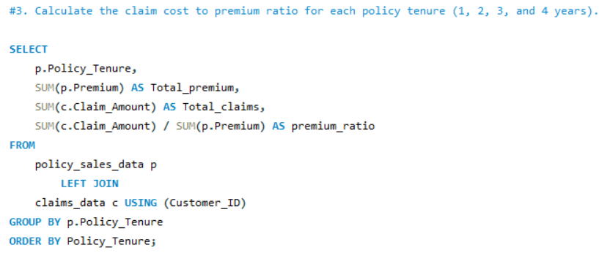
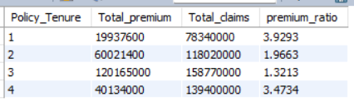
3-year policies might be most profitable because they generate higher premium while claims remain relatively low.
Lower ratio → more profitable policy
Higher ratio → higher risk

Slide 5
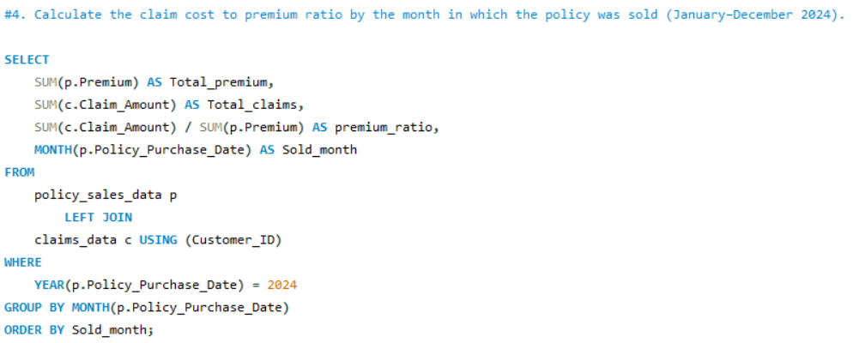
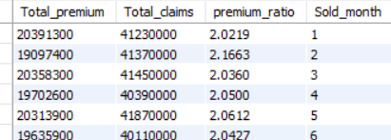
I grouped policies by the month of purchase in 2024
and calculated total premium and total claims for
each month. Then I computed the claim-to-premium
ratio using total claims divided by total premium.

Slide 6
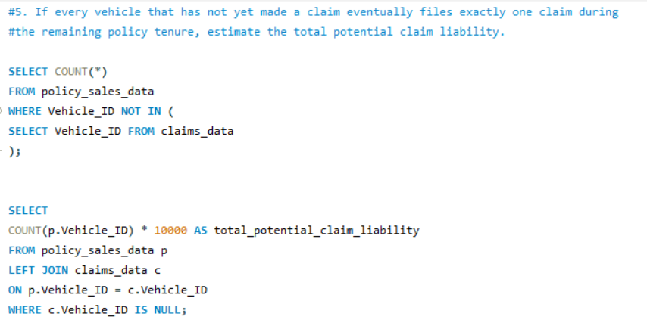


I identified vehicles without claims using a LEFT JOIN and NULL filtering, counted them, and multiplied by the claim amount of ₹10,000 to estimate the total potential claim liability.

Slide 7
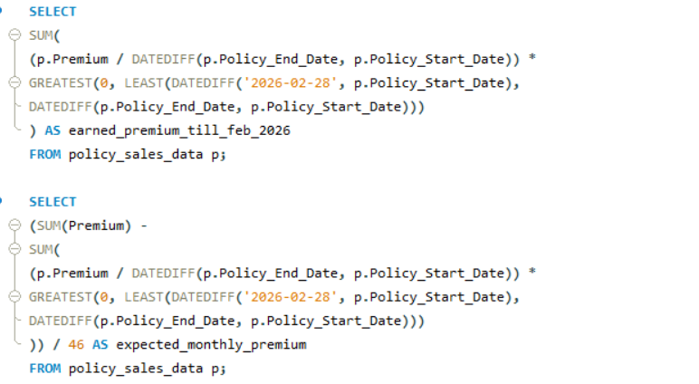


I calculated daily premium by dividing total premium by policy tenure days. Then I multiplied it by the number of earned days up to February 28, 2026 to estimate earned premium. Finally, I subtracted earned premium from total premium and divided the remaining amount by 46 months to estimate future monthly premium.

Slide 8
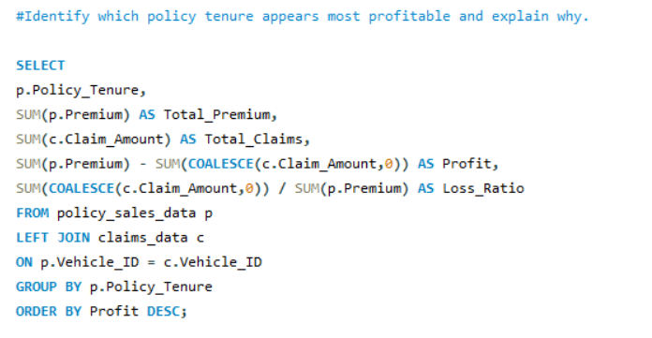
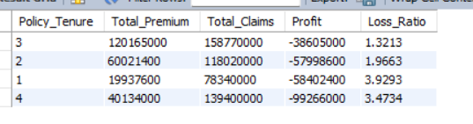
Bonus Questions
Based on the analysis, the 3-year policy tenure appears to be the most profitable. It generates the highest premium while maintaining a relatively lower claim-to-premium ratio compared to other tenures. This leads to higher overall profit and better risk-adjusted returns for the insurer.

Slide 9
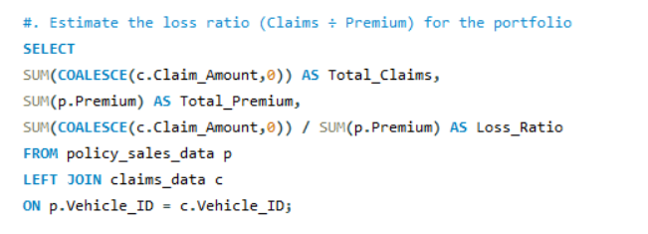

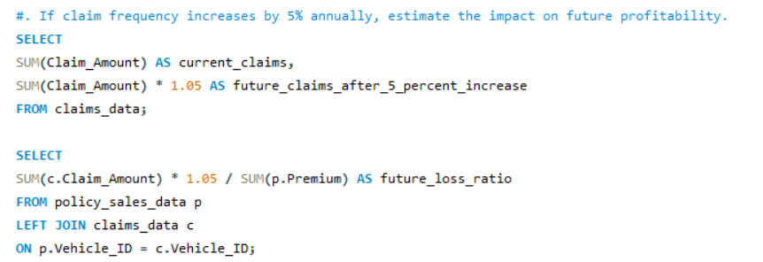


I calculated the loss ratio by dividing total claim cost by total premium collected across all policies. This metric helps evaluate the overall profitability and risk exposure of the insurance portfolio.

